Slide 1

Quiz Application
By-
Gogineni Sai Rohith (AP21110010219)
Ritesh (AP21110010260)
Ajay Kumar (AP21110010198)
Basheer (AP21110010203)

Slide 2
Modules Used
1. Login
2. Rules
3. Quiz
4. Score

Slide 3
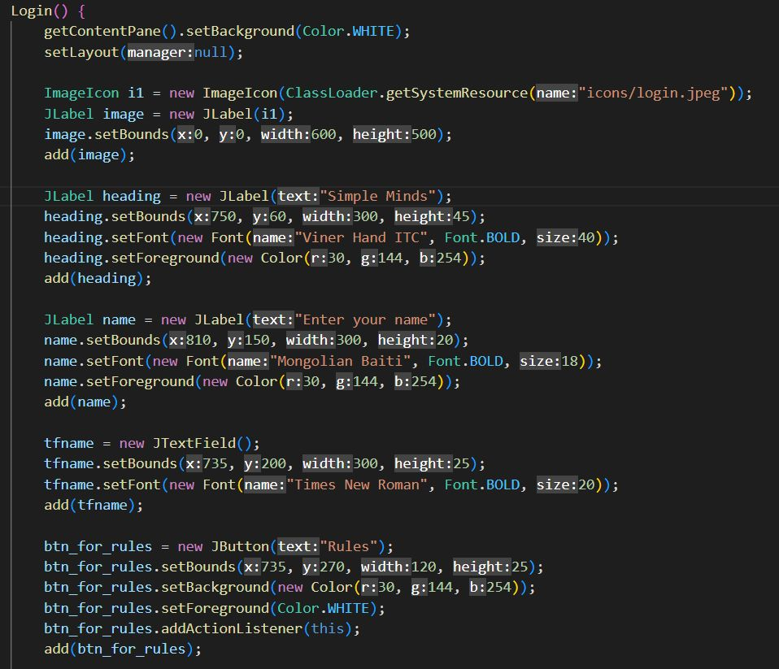
Login Class
The Login class in the quiz application represents the login screen. When an object of the Login class is created, the constructor initializes the window's properties. It sets the background color to white and adds an image as the background. The heading and label for entering the name are added, along with a text field for the user to input their name. Two buttons, "Rules" and "Back," are created and positioned on the screen. The window's size is set, and it becomes visible to the user.

Slide 4
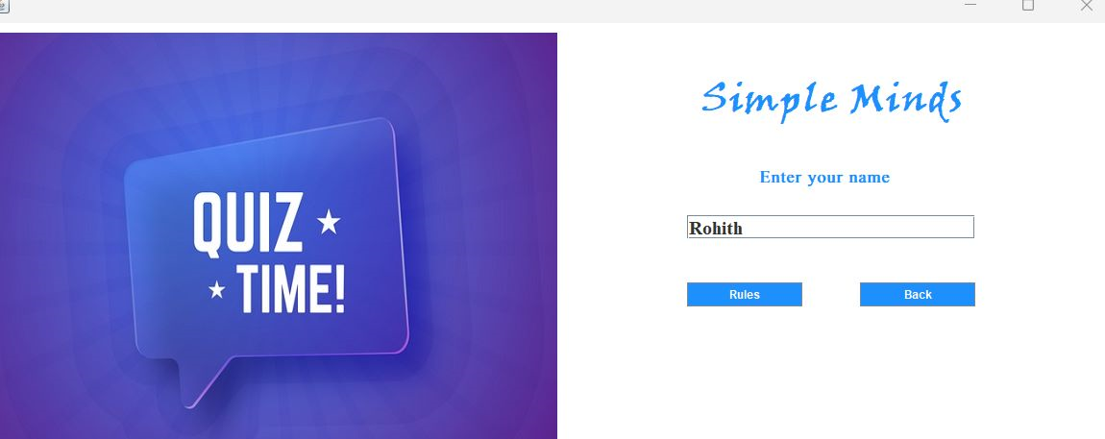
Login Class Output

Slide 5
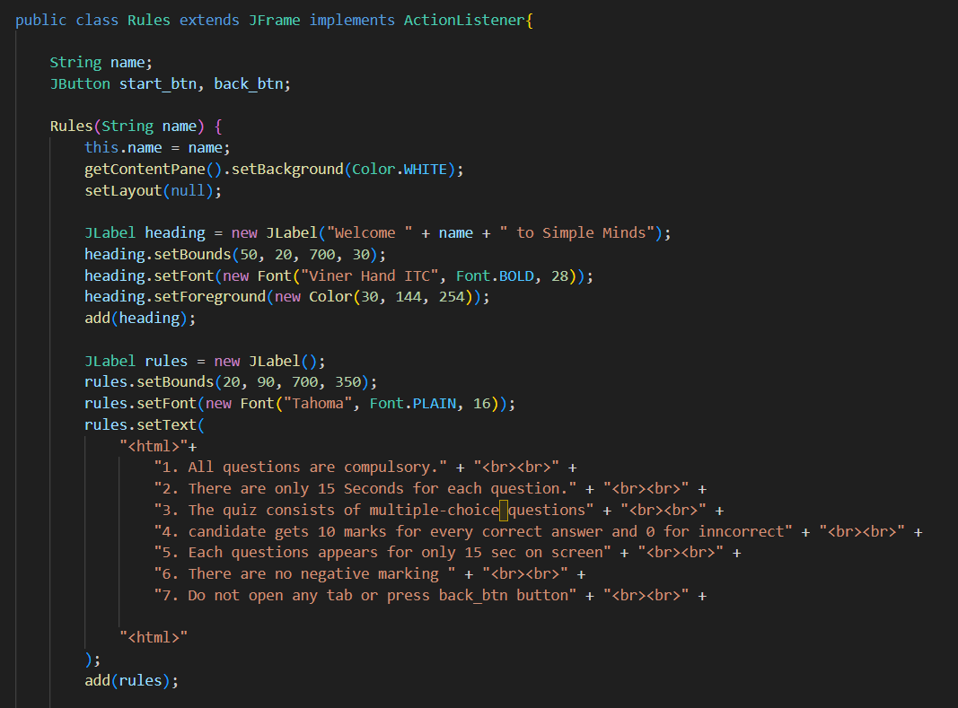
RULES Class
The Rules class in the provided code represents a JFrame-based frame that displays the rules of a quiz application. The constructor sets up the initial state of the frame by configuring its background color, layout manager, and size.
It creates and positions Swing components such as a heading label, a rules label, and two buttons: "Back" and "Start". The constructor also adds event listeners to these buttons to handle user interactions.

Slide 6
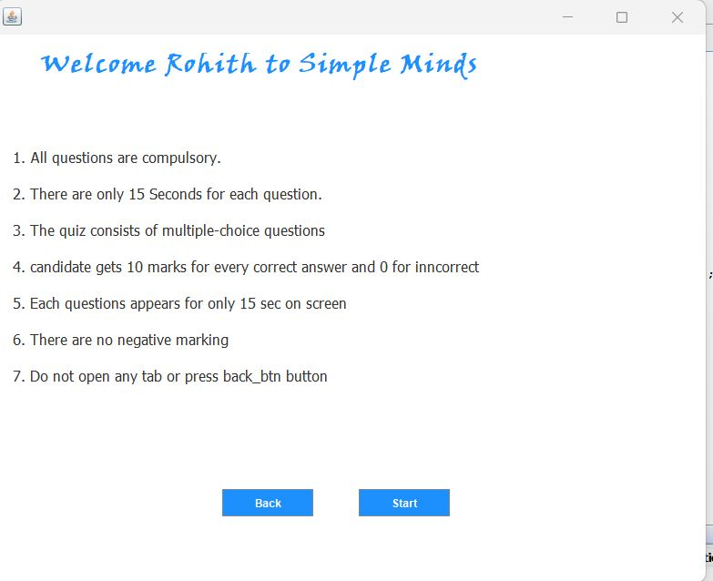
Rules Class Output

Slide 7
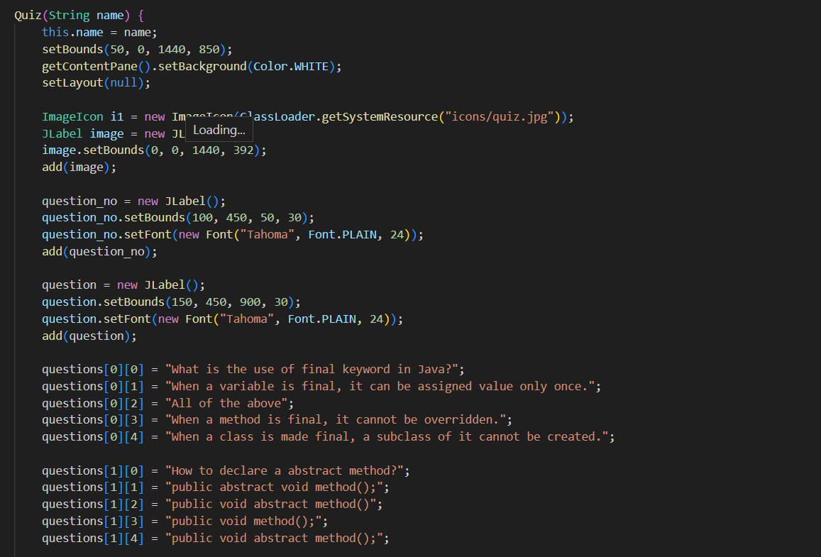
Quiz Class
The Quiz class is the main class that represents the quiz application. It extends the JFrame class, which provides a window for the graphical user interface. The class also implements the ActionListener interface to handle user actions such as button clicks.
In the constructor of the Quiz class, the user's name is passed as a parameter, and the layout and visual elements of the application are set up. The quiz questions and answers are initialized in arrays, and the GUI components such as labels, radio buttons, and buttons are created and added to the frame. The start() method is called to display the first question.

Slide 8
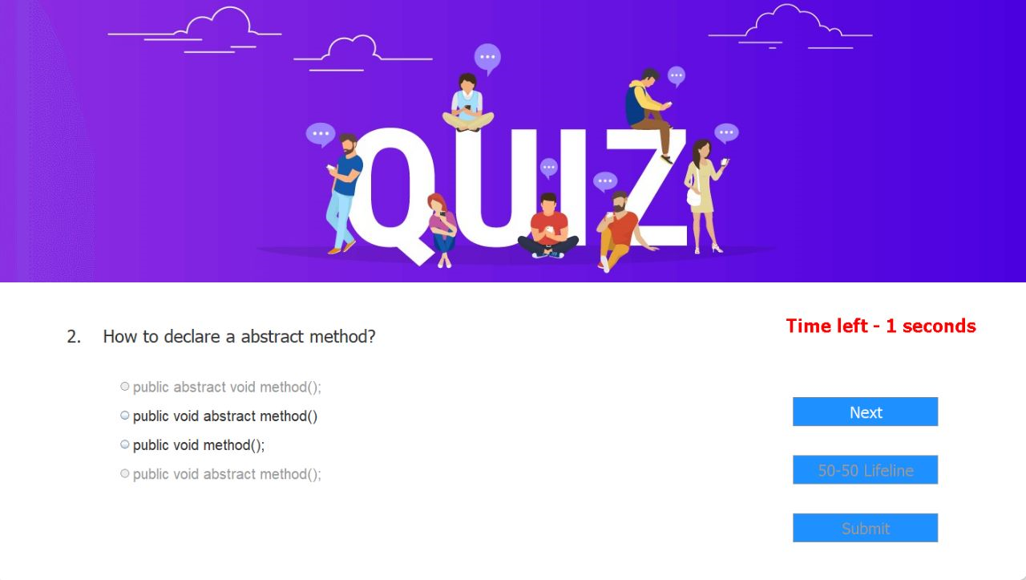
Quiz Class Output

Slide 9
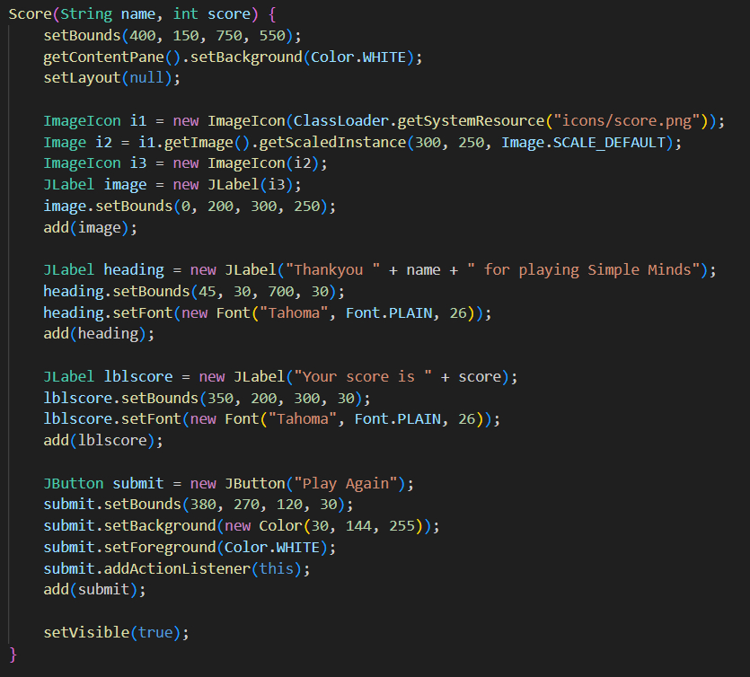
Score
The Score class is responsible for displaying the score window at the end of the quiz. When an object of the Score class is created, the constructor sets up the window's properties, including its position, size, and background color.
It also adds a label with a customized message to thank the player for playing the quiz, along with their name. The player's score is displayed using another label. An image is added to the window, showing a score icon. Finally, a "Play Again" button is created to allow the player to start a new quiz.

Slide 10
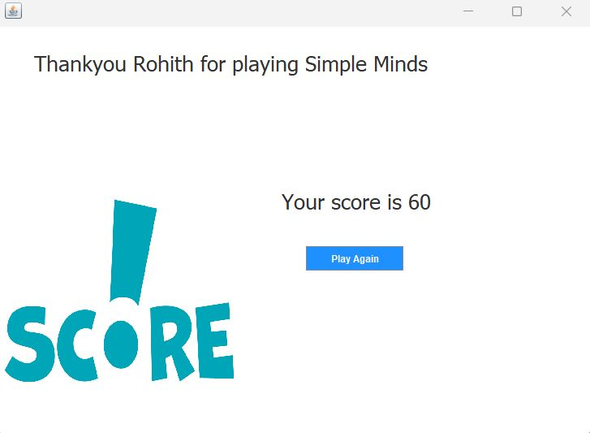
Score Class Output
The Final Score is displayed here

Slide 11
Conclusion
In conclusion, the development of our Java Quiz Application has been a challenging yet rewarding journey. Throughout this process, we have aimed to create a user-friendly and interactive platform that enhances the learning experience for Java enthusiasts. Our application not only tests the knowledge of users but also provides The Score at the end of the quiz, allowing them to expand their understanding of Java programming concepts.
By incorporating a variety of question types, including multiple choice, true/false, and coding challenges, we have strived to cater to different learning styles and levels of expertise. The randomized question selection ensures that each quiz session is unique and engaging, promoting continuous learning and growth.

Slide 12
THANK YOU

